Slide 1

Opening a new restaurant in Denver CO
COURSERA CAPSTONE
By: Mohandas palatshaha
12 Jan 2021

Slide 2
Agenda
Business Problem
Data
Data Sources
Data Gathering and Data Cleansing
Methodologies used
Outcome
Recommendations and Way Forward
References

Slide 3


Business problem
Indian food is one of the most famous dining items in the world . We are planning to open up a new Indian Restaurant in Denver CO
We observe that there are several well-established Indian Restaurants across the city of Denver
To be successful in the business, we need to analyze the most suitable place to face least competition
The project aims at analyzing and selecting the best location in Denver CO for opening a new Indian restaurant

Slide 4
Data
Data Sources:
Denver sub urbs wiki page: https://en.wikipedia.org/wiki/List_of_neighborhoods_in_Denver
Geocoder library to obtain latitude and longitude data
Foursquare APIs to pull up venues in Denver neighborhood

Slide 5
Data gathering and cleansing
Sub urb information for Denver city is pulled up from WIKI page using web scrapping methodology
This scraped data is then converted into data frame using BeautifulSoap Python library
Latitude and Longitude information is collected from Geocoder library from Python
Venue information is being pulled from Foursquare APIs

Slide 6

Methodologies used
Denver neighborhood data pulled from web scrapping of Wikipedia page for Sub Urbs in Denver area
The data is cleansed and converted to pandas data frame using BeautifulSoap library
Latitude and longitude data for the gathered data supplemented using Geocoder.
Used Foursquare APIs to pull up top 50 venues within Denver city.
The venues pulled henceforth are filtered to check only Indian restaurants within Denver
The filtered data is used to for clustering.
K-means clustering used to cluster Indian Restaurants across the city
Data is divided into 5 clusters

Slide 7
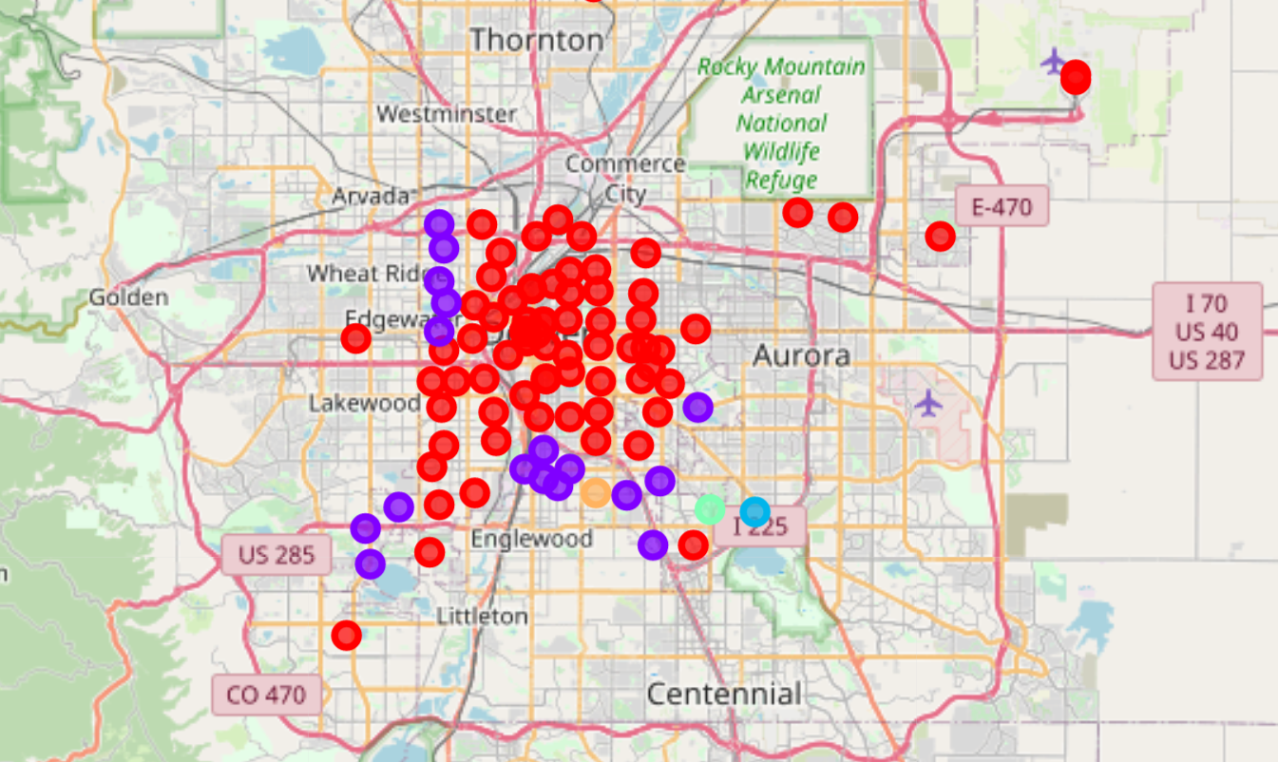

outcome
Most of the Indian Restaurants are concentrated in Cluster 0 and 1 i.e. around central and northern part of the city
We hardly see any Indian Restaurant near outskirt of the city i.e. Englewood and Centennial area
Opening restaurant in outskirt of Denver could be beneficial in regards with the competition

Slide 8

Recommendations & way forward
Based on the clustering results, we should think about opening Indian restaurants near to cluster 2,3 or 4 i.e. Englewood or Centennial area
The analysis done here took into consideration only one variable i.e. frequency of Indian Restaurants at given geography
For better results we should consider additional variables such as population spread , favorite tastes of the people living across, ease of transportation to the site

Slide 9
references
https://en.wikipedia.org/wiki/List_of_neighborhoods_in_Denver
https://developer.foursquare.com/docs

Slide 10
Thank you
Mohandas palatshaha
Mohandas.palatshaha@gmail.com

